Slide 1


Fundamentals of RM
RM System and Process
Leadership in RM
Incident Investigation
RM Tools & Challenges
RM in Industry
People & Org.
Application and Perspectives
On Becoming a
Leader in Risk Management
ENGG404 - Lecture
Chapter 2.2:
Anatomy of an Incident &
Case 16: The Fernie Memorial LI

Slide 2
Learning Outcomes:
Apply observation skills and supposition skills to analyze a typical activity and possible loss incident for hazards & consequences.
Apply two different models to examine the components of an incident.
Chapter 2.2 Anatomy of an Incident
2
Notes:
2

Slide 3
Activity, Hazards, Consequences, and Loss Incident:
An activity describes a situation where things are being done. Activities are often associated with hazards. An activity can describe:
A task or job being performed by a person.
  Examples: ascending a ladder, operating a crane, driving a truck.
A complex set of unit process operations in an industrial facility.
  Examples: a tank used for storing materials; a mine; a drilling rig; a rail-car loading facility.
Hazards are “things” that can do harm, and help inform us about
“What can go wrong”
Consequence is “How bad it can be” if something goes wrong (described as the negative impacts on PEAP, or losses)
A Loss Incident is an unplanned, undesired event that resulted in a loss.
Chapter 2.2 Anatomy of an Incident
3
Notes:
3
Incident versus accident – make the distinction here

Slide 4
Importance to Learn How and Why Incidents Occur:
Q: Why it is important to understand and analyse how and why incidents occur?
We want to learn from our own incidents AND also from others.
The purpose in examining:
an activity is to prevent a loss incident – proactive.
an incident is to:
    prevent its recurrence – reactive / responsive (our incidents).
    prevent it from happening at our workplace - proactive (others’ incidents).
Chapter 2.2 Anatomy of an Incident
4
Notes:
4
When we examine activities, that’s when we also find efficiencies in productivity (i.e. how an RM program increases profit by minimizing loss)

Slide 5

ALE #1: An Activity and its Hazards and Consequences:
Please confer (Zoom Chat):
Q: In this photo: what are some plausible activities?
Chapter 2.2 Anatomy of an Incident
5
Notes:
5

Slide 6
ALE #2: An Activity and its Hazards and Consequences:
Please confer:
With a common understanding of the plausible activities, what are the hazards & associated consequences?
Respond as “hazard-consequence”
e.g. “cold water – hypothermia” (Zoom Chat)
Chapter 2.2 Anatomy of an Incident
6
Notes:
6

Slide 7
Activity – Fishing In A Row Boat
Hazards - Consequences
Water (cold water) – Hypothermia, drowning
Sitting on the edge – Falling out, drowning
Unstable boat for a big fish – falling out, drowning
Rough waters (waves, swell) – falling out, boat is swamped, boat sinks
Gusting winds – boat is swamped, boat sinks
Intoxicated – “at risk” behaviours
Not wearing a PFD – drowning
Sunny day, high UV – sun burn
Hot day – hyperthermia, heat related illness
Chapter 2.2 Anatomy of an Incident
7
Notes:
7

Slide 8
How Loss Incidents Happen:
Hazards & causes that result in losses must be understood.
To understand the causes, the components of what makes an incident must be understood.
First, two broad types of loss incidents:
  Workplace (Occupational) Safety
  Process Safety
The Incident Model is presented to explain how loss incidents happen.
  Note: This Model is one of many, many different models!
Chapter 2.2 Anatomy of an Incident
8
Notes:
8
Occupational safety – keeping people safe at work
Process safety – keeping it in the pipe or tank, control over the material you’re working with

Slide 9





ALE #3: The Incident Model:
The Incident Model is a combination of:
… will result in a loss incident.
A triggering event may:
Please confer on an example!
Energy Source
Line of Fire
Loss Incident
Control Measures
Chapter 2.2 Anatomy of an Incident
9
Notes:
9
Use example in the classroom – overhead projector, etc

Slide 10
Example: The Incident Model:
The Incident Model is a combination of:
Energy (controlled or uncontrolled release, or
protected / unprotected exposure to a source), and
Line-of-Fire (no safe distance, separation, or space;
intentional or not intentional), and
Control Measures (inadequate, defective,
ineffective, or lack of)
… will result in a loss incident.
A triggering event (dashed lines) may:
Put someone or something in the
line of fire, or
Initiate the release of an energy
source, or
Defeat a control measure.
Something falls (energy), the person is under it, and is not wearing a hard hat.
Energy Source
Line of Fire
Loss Incident
Control Measures
Chapter 2.2 Anatomy of an Incident
10
Notes:
10
Use example in the classroom – overhead projector, etc

Slide 11
Applications of the Incident Model:
Can be applied to analyze a loss incident …
Can be applied to analyze a set of conditions or circumstances that may lead to a loss incident …
Energy Source
Line of Fire
Loss Incident
Control Measures
Chapter 2.2 Anatomy of an Incident
11
Notes:
11

Slide 12
The Fernie Memorial Arena – Refrigeration Primer:
Activity/Process: Refrigeration process uses ammonia and brine to make ice surfaces for skating, hockey, and curling
Key Hazard: Ammonia contained in piping (highly toxic, reactive, corrosive, operates at higher pressure than brine)
Refrigeration process critical component - the brine chiller: brine solution flows through tubes inside a heat exchanger; ammonia liquid in side the shell of the heat exchanger and over the outside of the tubes full of brine; the cooler ammonia liquid cools the hotter brine; the brine flows to the sub-surface pipes in the ice rink to create ice.
Critical to keep ammonia gas (high pressure system) from leaking into the brine (low pressure system) system.
Consequence if it does: ammonia gas over-pressures and ruptures the lower-pressure-rated brine piping system, resulting in a leak of ammonia gas into the work space.
Chapter 2.2 Anatomy of an Incident
12
Notes:
12

Slide 13
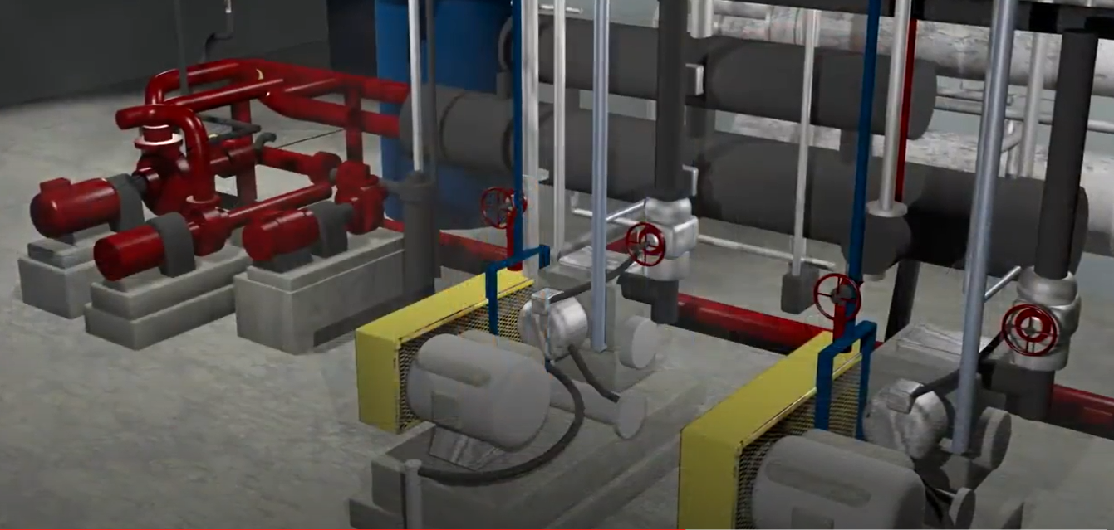
Ammonia Leak at The Fernie Memorial Arena LI:
Prior to the Incident:
Refrigeration Equipment:
~ 30 years old at time of incident
Life span: 20-25 years
Oct 5, 2010 – recommendation to replace equipment
Jan 4, 2011 – another recommendation to replace eqpt
Pin-hole leak in the chiller brine tube developed over time due to corrosion
Pin-hole leak was not repaired during the 2017 Summer Shutdown
(not known if or when it was detected)
Chiller was put back into service on Oct. 16, 2017, 06:00 AM
Brine Recirculation Pumps
Ammonia Compressors
Chapter 2.2 Anatomy of an Incident
13
Notes:
13

Slide 14
Ammonia Leak at The Fernie Memorial Arena LI:
Date of incident: Oct 17, 2017
Early morning: Ammonia escaped into the mechanical / compressor room at the Fernie Arena
03:52 AM: Ammonia monitoring system triggered alarms in response to the leak
Emergency responders and workers responded to alarms and entered the mechanical room wearing self-contained breathing apparatus; ammonia concentration was 300 ppm, IDLH
Emergency responders ventilated the building to reduce ammonia concentration, 50 ppm
City worker isolated the leaking chiller, shutdown the system, and dismissed the emergency responders
City workers subsequently decided to restart the compressor but could not because the compressor oil was contaminated with brine (compressors are on the ammonia system)
Refrigeration mechanic assigned to change compressor oil
Ammonia alarm was silenced
9:00AM: The mechanic and the two city workers entered the compressor room to change the oil without adequate safeguards and control measures (no SCBA PPE, no personal exposure monitors, no back-up team, no emergency responders)
Since the chiller start-up the previous day, ammonia continued to leak into the brine piping system and building pressure in the brine system
9:30AM The brine system over-pressure eventually caused a piping component to fail catastrophically; bine-ammonia mixture rapidly sprayed the workers and filled the room
Ammonia concentrations were not survivable
Impact on PEAP: three fatalities (P), leak of toxic material (E), ? (A), rinks out of use for a period of time, schedule disruption (P)
Chapter 2.2 Anatomy of an Incident
14
Notes:
14

Slide 15
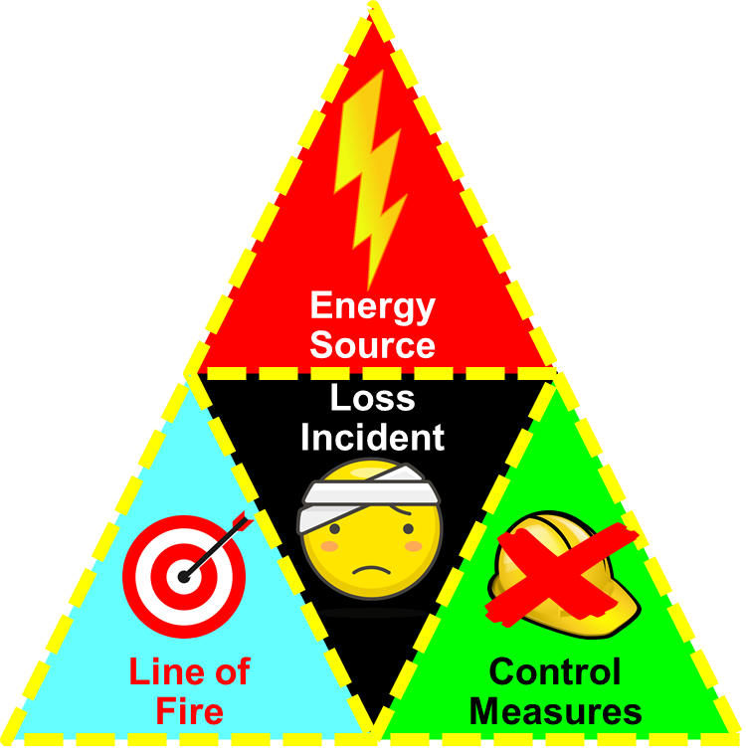
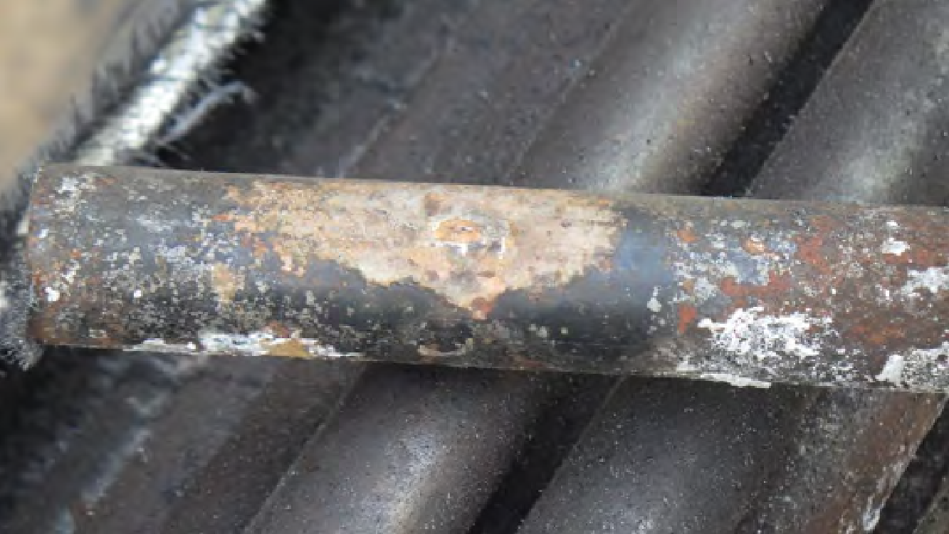
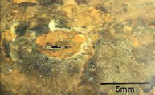
ALE #4: Ammonia Leak at The Fernie Memorial Arena LI:
Please confer:
What components of the Incident Model do you see? (MM-Poll)
Type of incident: Occupational Safety or Process Safety? (MM-Poll)
If you were in charge of Alberta OH&S, what would you do in response to reading the WorkSafeBC Report?
(MM-Poll)
Image courtesy of Technical Safety BC. Accessed at: https://www.technicalsafetybc.ca/sites/default/files/2018-07/FaultTrees/TSBC_257671_InvestigationReport_v14_online.pdf
Chapter 2.2 Anatomy of an Incident
15
Notes:
15

Slide 16
Ammonia Leak at The Fernie: A Deeper Dive Into The Incident
Components of the Incident Model?
Line of Fire:
Workers went into the maintenance building
Lack of Control Measure:
Workers did not clear the inside air before entry
Workers did not wear breathing apparatus
Loss of containment (loss of “control”) of ammonia
Energy Source:
Ammonia, a compressed toxic gas
Trigger:
Non-detected corrosion of the piping system
/ inadequate corrosion monitoring of the ammonia chiller tubes
Chapter 2.2 Anatomy of an Incident
16
Notes:
16

Slide 17
Ammonia Leak at The Fernie: A Deeper Dive Into The Incident
Type of incident: “Occupational Safety” or “Process Safety”? Both!
OS: Failure to wear PPE, respiratory protection, breathing apparatus
PS: Failure to prevent corrosion of the piping system
If you were in charge of Alberta OH&S, what would you do in response to reading the WorkSafeBC Report?
November 2017: WorkSafe BC kicked off a 3 phase review
Phase I – 180 of 223 rinks in BC use ammonia
Phase II – review of contractors who work on ammonia systems
Phase III – review other BC industries that use ammonia (food processing, industrial chemical manufacturing)
Chapter 2.2 Anatomy of an Incident
17
Notes:
17

Slide 18
Summary and Key Lessons:
All activities have associated hazards; uncontrolled hazards lead to consequences.
Understanding and analyzing the why & how of incidents are important for learning to prevent loss incidents.
The best organizations learn from both their incidents & those of others.
Occupational and process safety are related & both are important.
The Incident Model:
Energy,
Line of Fire,
Control Measures,
A Triggering Event
Chapter 2.2 Anatomy of an Incident
18
Notes:
18

Slide 19
Any questions?
Notes:
19

